Slide 1
SAPW – Treatment Criteria
South American Palm Weevil, Parks and ROW, Encinitas, CA

Slide 2
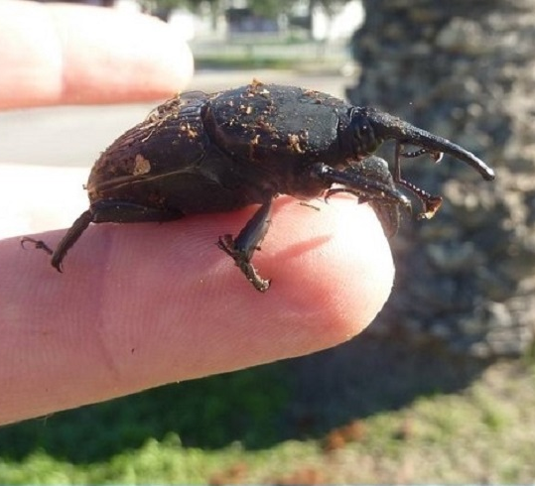
SAPW Overview
Is a non-native pest of palms that has established populations in San Diego County.
Adults are strong daytime fliers
Causes significant damage that will result in the death of meristematic tissues. Once meristematic tissue is destroyed, it results in palm mortality.
Symptoms include yellowing of foliage, flattening of crown, pupal cases on ground, holes/frass or tunnels at base of fronds
Early detection is difficult

Slide 3
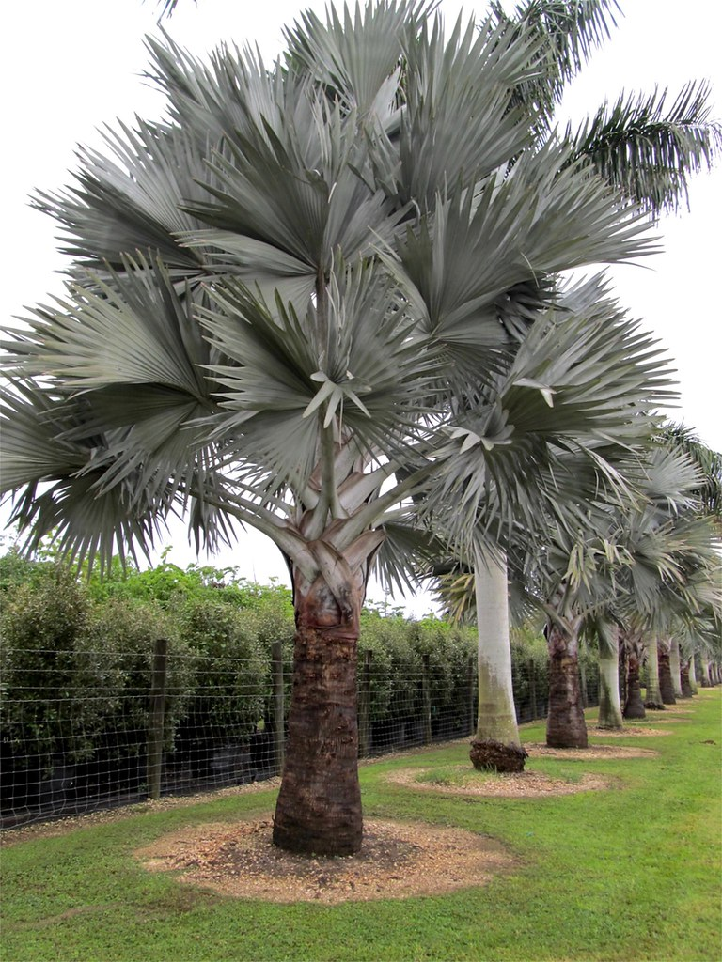
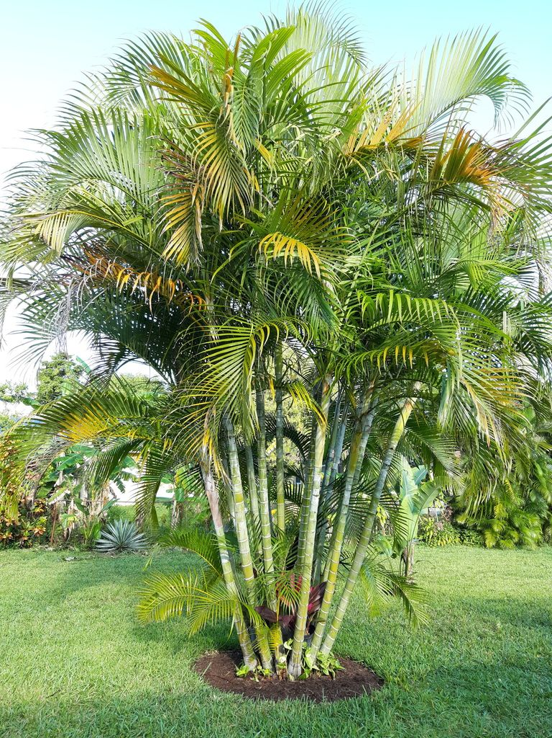
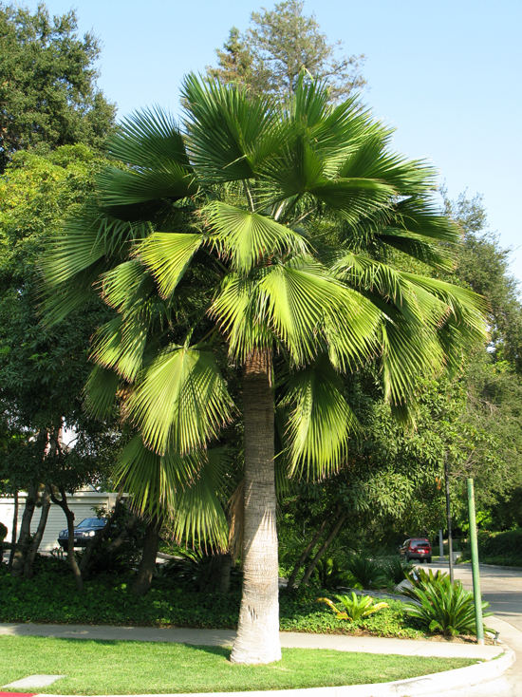
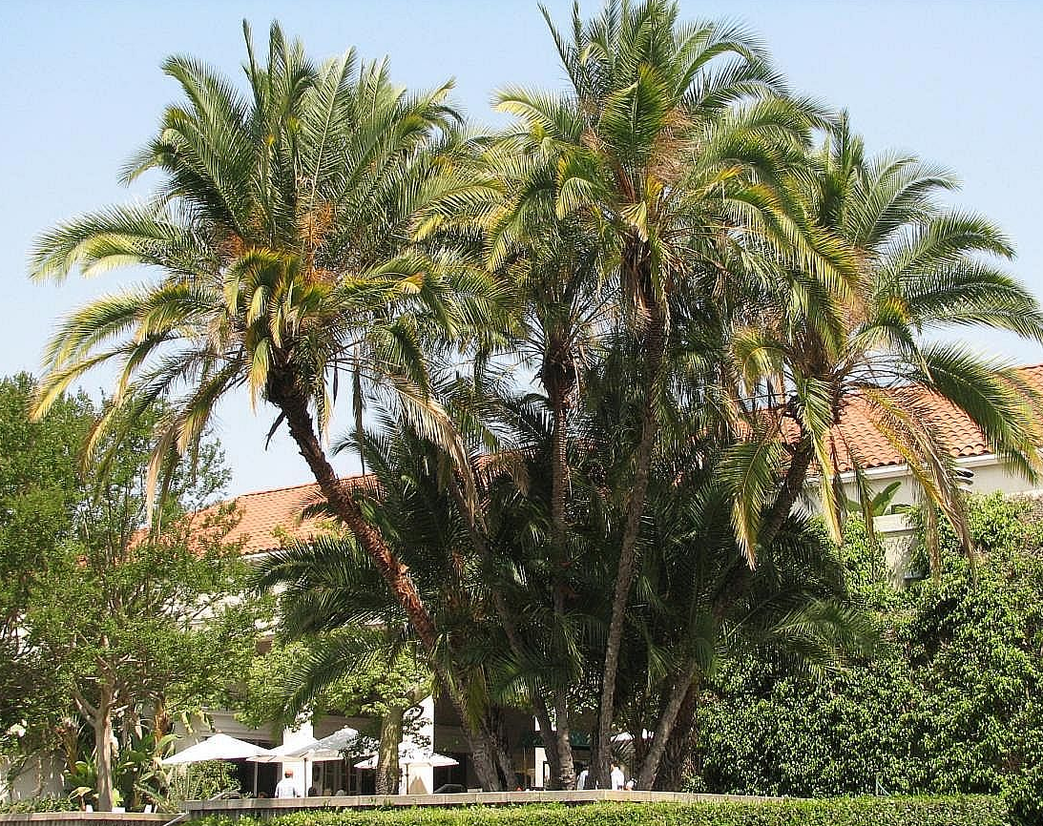
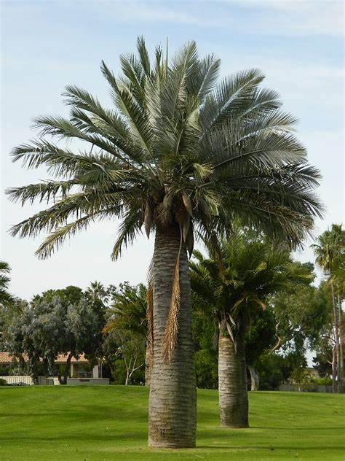
Hosts
Prefers Canary Island Date (Phoenix canariensis)
Alternative hosts include: Bismarkia spp., Brahea spp., Dypsis spp., Jubaea chilensis, Phoenix reclinata, Phoenix dactylifera, Pritchardia spp., Sabal palmetto, Washingtonia spp.
Will feed on avocados, pineapple, papaya, citrus, mango, banana, guava

Slide 4
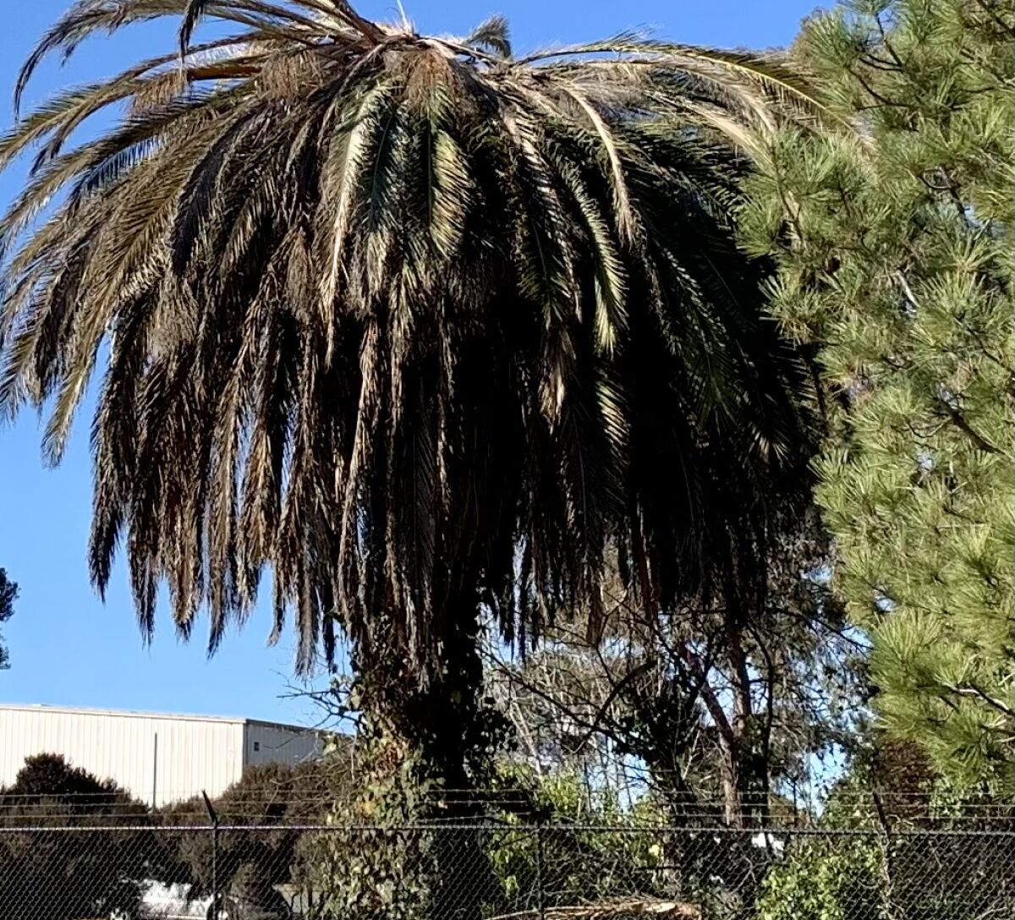
Inspection Methods
Followed BMPs for identifying infestations (Industry Standard)
Ground level visual inspection of the crown, stem, and visible root collar.
236 CIDP’s in ROW, 44 in Parks
Identified trees that are special to neighborhoods or streets and treat?

Slide 5
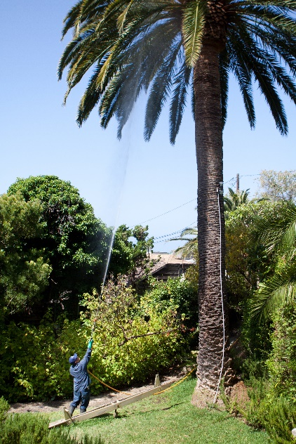
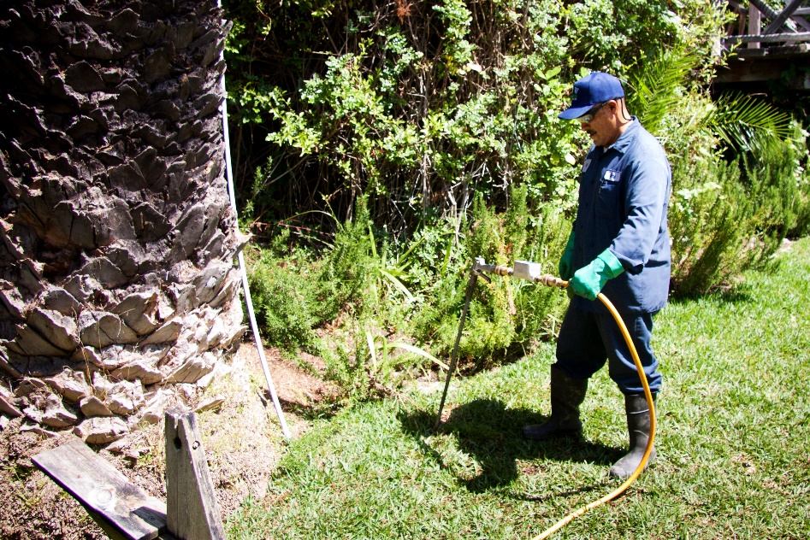
Treatment Methods
1) Systemic pesticides are at present the most effective tool available for protecting palms from SAPW infestations.
2) Systemic pesticides (mainly neonicotinoids) are translocated within the palm and accumulate in the meristematic tissue where weevil larvae feed.
3) Systemic pesticides can be applied as soil drenches, soil injections, trunk sprays or paints, trunk injections, or as drenches applied to the crown.
4) Contact insecticides (i.e., pesticides that either kill on contact or leave a dry external residue that is lethal upon contact) can be applied to palm fronds or pruning wounds to kill adult weevils attracted to these substrates.
5)Developing a pesticide treatment program should be made in consultation with a professional arborist, and two or more applications per year may be needed in infested areas to protect palms from weevil attack.

Slide 6
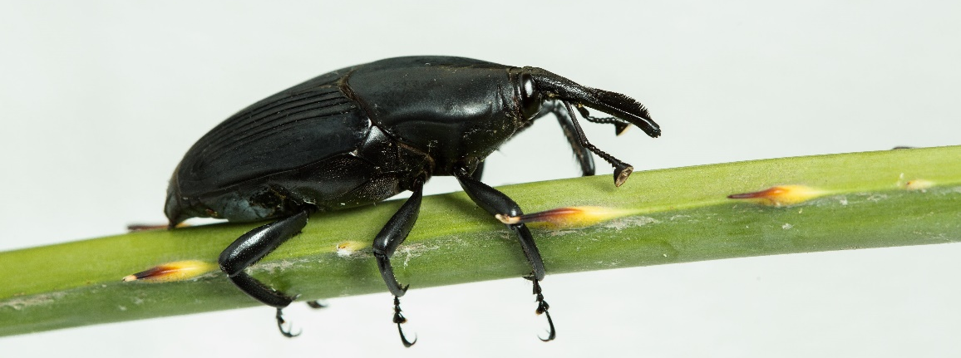
Treatment Frequency and Costs
1) Palms are recommended for treatment 4x per year annually.
2) Cost to Treat an Individual Palm (4x/year) is approximately $1,145.50/palm or $286.25/treatment
3) To treat all the CIDP’s in the City, for one year, the cost would be approximately $320,740 annually.

Slide 7
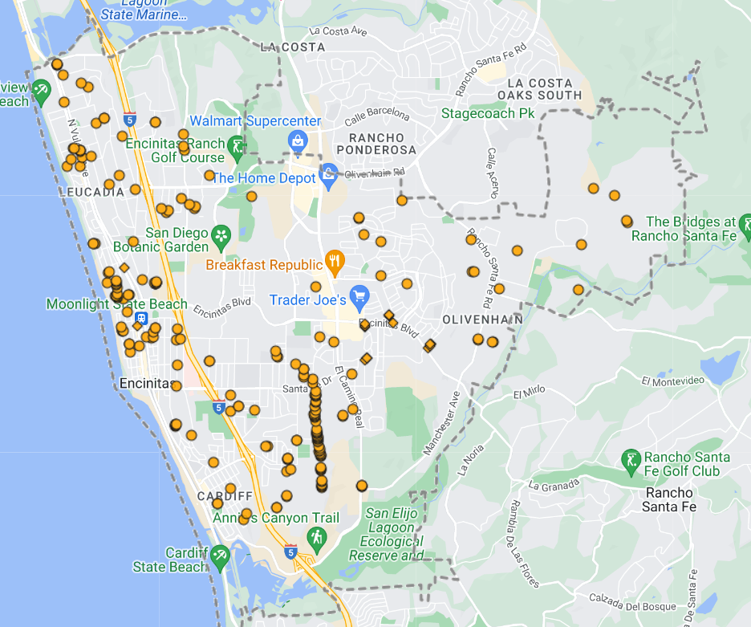
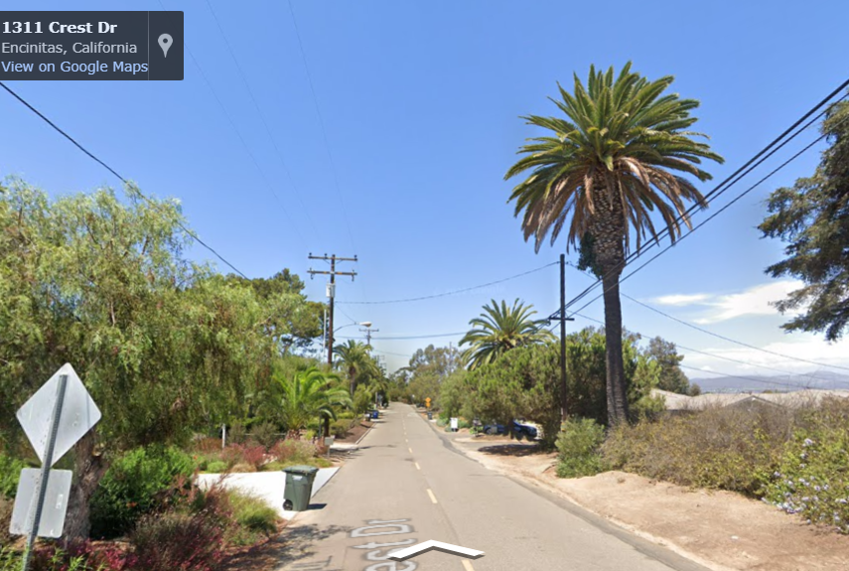
What Should the Preventative Treatment Vs. Non-Treatment Criteria Consist of?
Health: Only those in good health and Structure
Location: What trees are considered landmarks of a neighborhood?
Size: Those that are the biggest in the City
Quantity in a Neighborhood: Should areas of higher density be treated vs. 1 here and there?
Visual Impact: Consider their aesthetic value and how their removal might affect the overall appearance.
Cultural Significance: Some trees hold cultural, historical, or religious importance to local communities.

